Slide 1
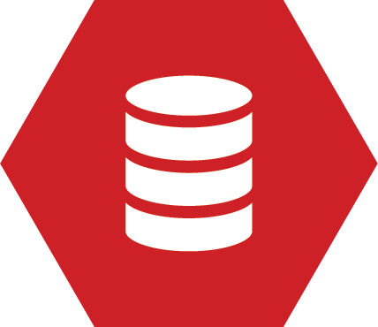
Continuous Integration for Databases
Learn how to automate your build and test
Part II of the Continuous Delivery for Databases series
Steve Jones
Red Gate Software

Slide 2
Agenda
Goals
Who am I?
What is Continuous Integration?
Fitting in the Delivery Pipeline
What is “build” for databases?
Testing in a CI process
Adding data for realism

Slide 3
Goals
Why continuous integration?
Testing is important
It’s easy – setup and running in an hour
Do feel free to ask questions!

Slide 4
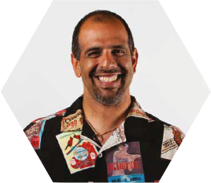



Get in touch
Steve Jones
Editor and founder, SQLServerCentral
Evangelist, Red Gate Software
Working with SQL Server since 1991 (v4.2)
Author of many articles and books on different aspects of SQL Server
http://voiceofthedba.wordpress.com/
sjones@sqlservercentral.com
@way0utwest

Slide 5
What is continuous integration?
“Continuous Integration is a practice designed to ensure that your software is always working, and that you get comprehensive feedback in a few minutes as to whether any given change to your system has broken it.”
Jez Humble, ThoughtWorks, author of “Continuous Delivery”

Slide 6
database
^
What is continuous integration?
“Database Continuous Integration is a practice designed to ensure that your database software is always working, and that you get comprehensive feedback in a few minutes as to whether any given change to your system has broken it.”
Jez Humble, ThoughtWorks, author of “Continuous Delivery”

Slide 7
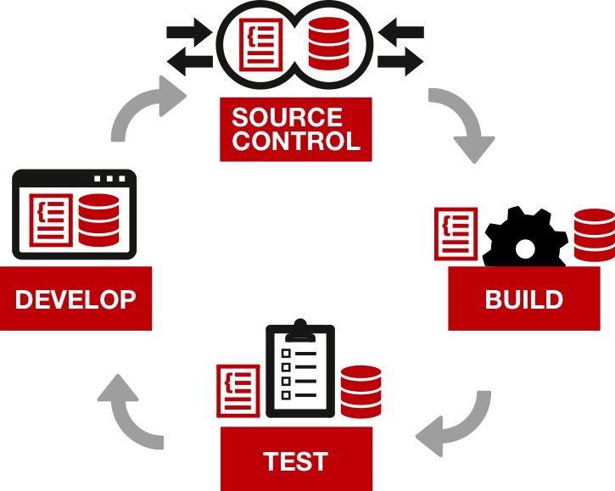
Continuous delivery – an overview

Slide 8
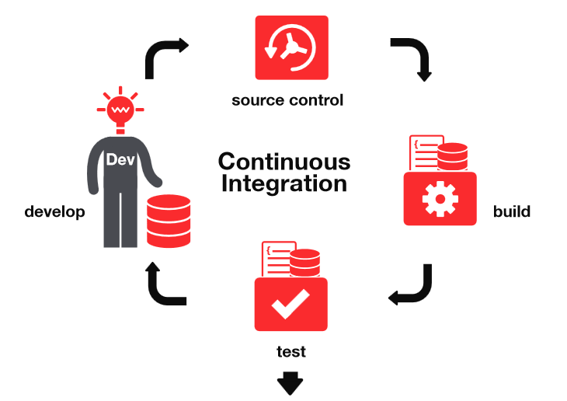
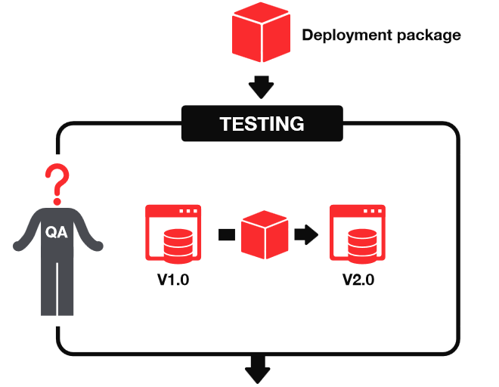


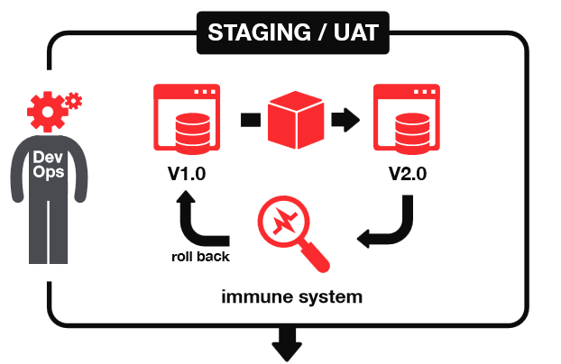
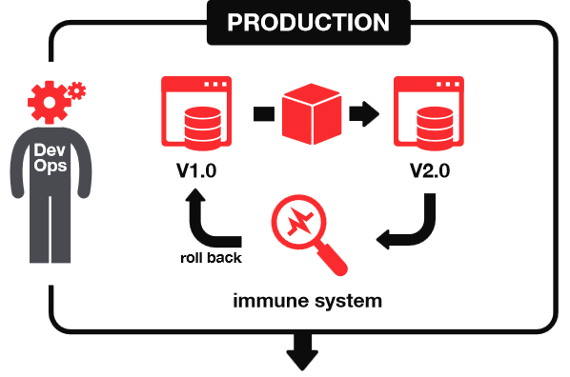

Continuous delivery
1
2
START
3
4
DELIVER

Slide 9
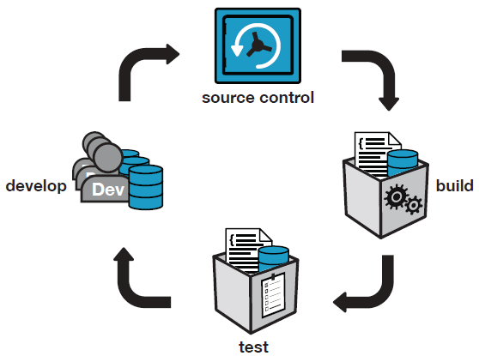
Database Continuous Integration
Notes:
CI server is set up by one person and the whole team of developers benefits.

Slide 10
What is build?
For application code = compile
For database code = database creation script
But only for a new installation!
Upgrade scripts required for existing installations
Need to preserve the state of the data
Notes:
The testing of deployment scripts is customarily left to the end.
=> Issues with upgrades only found at the end of a project.

Slide 11
Tools we need
CI server
Perform the build for us
Execute steps we program
Choices
TeamCity by JetBrains
Jenkins – open source
Bamboo – Atlassian
TFS Build - Microsoft
Cruise Control – open source
Notes:
Show of hands for SQL Developer Bundle.
TeamCity is used at Red Gate but *any* build server can be used, eg:
Jenkins, Hudson, TFS Build, CruiseControl, Bamboo, etc.
There is a sqlci.exe command line, and NAnt and MSBuild template wrappers available.

Slide 12
Tools we need
CI server
Perform the build for us
Execute steps we program
Choices
TeamCity by JetBrains
Jenkins – open source
Bamboo – Atlassian
TFS Build - Microsoft
Cruise Control – open source
Notes:
Show of hands for SQL Developer Bundle.
TeamCity is used at Red Gate but *any* build server can be used, eg:
Jenkins, Hudson, TFS Build, CruiseControl, Bamboo, etc.
There is a sqlci.exe command line, and NAnt and MSBuild template wrappers available.

Slide 13
Tools we need
Database Integration
Check out schema from VCS
Execute against a SQL Server instance.
Run tests
Choices
Red Gate SQL Automation Pack
PoSh
.NET scripts/program
?
Notes:
Show of hands for SQL Developer Bundle.
TeamCity is used at Red Gate but *any* build server can be used, eg:
Jenkins, Hudson, TFS Build, CruiseControl, Bamboo, etc.
There is a sqlci.exe command line, and NAnt and MSBuild template wrappers available.

Slide 14
Tools we need
Version Control
Store our database DDL and DML
Choices
Subversion
Team Foundation Server
Git
Mercurial
Visual SourceSafe
?
Notes:
Show of hands for SQL Developer Bundle.
TeamCity is used at Red Gate but *any* build server can be used, eg:
Jenkins, Hudson, TFS Build, CruiseControl, Bamboo, etc.
There is a sqlci.exe command line, and NAnt and MSBuild template wrappers available.

Slide 15
Tools we need
Testing framework
We need a way to unit test our code easily.
A framework allows us to write tests that we can maintain
Choices
tSQLt and SQL Test
TSQLUnit
TST
Notes:
Show of hands for SQL Developer Bundle.
TeamCity is used at Red Gate but *any* build server can be used, eg:
Jenkins, Hudson, TFS Build, CruiseControl, Bamboo, etc.
There is a sqlci.exe command line, and NAnt and MSBuild template wrappers available.

Slide 16
Tools we need
Test data
We want to have data for our tests
Choices
Red Gate SQL Data Generator
Restore known backup
Custom scripts for data load (DML and or BCP)
Notes:
Show of hands for SQL Developer Bundle.
TeamCity is used at Red Gate but *any* build server can be used, eg:
Jenkins, Hudson, TFS Build, CruiseControl, Bamboo, etc.
There is a sqlci.exe command line, and NAnt and MSBuild template wrappers available.

Slide 17
Our story…
We want to set up a CI process for our database
Our database is in a VCS
We need to automatically build a new database on every checkin
Notes:
Needs a new name, but this is where we talk about our demo app slightly (or code). Give a first requirement we need to do.

Slide 18
Demo
Continuous Integration Setup

Slide 19
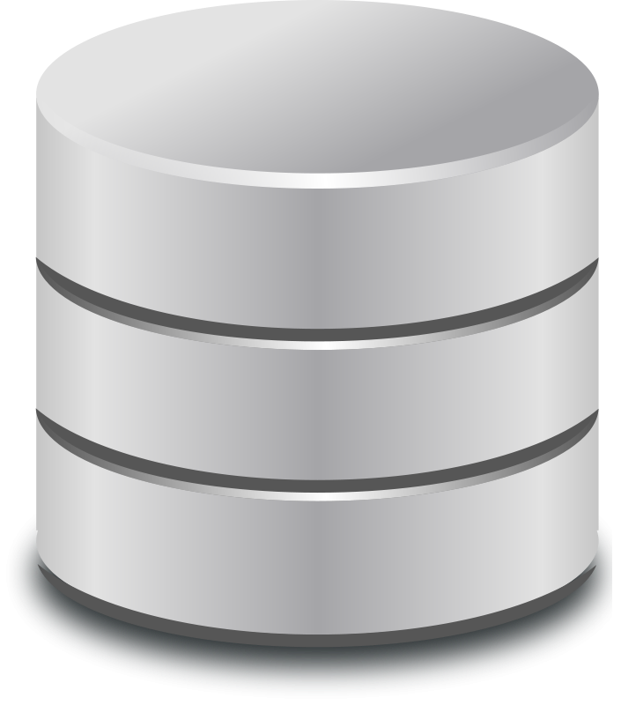
The CI Database Setup
Repository
CI Server
Developer
Integration Database

Slide 20
The CI Database Setup
Repository
CI Server
Developer
Integration Database

Slide 21
The CI Database Setup
Repository
CI Process
CI Server
Developer
Integration Database

Slide 22
The CI Database Setup
Random Test Database
Repository
CI Process
CI Server
Developer
Integration Database

Slide 23
The CI Database Setup
Repository
CI Process
CI Server
Developer
Integration Database

Slide 24
Keeping a database up to date
With?
Schema
Static data
Why?
A corresponding database for the application
Maintaining a test database with the latest changes

Slide 25
Testing
Why it’s important

Slide 26
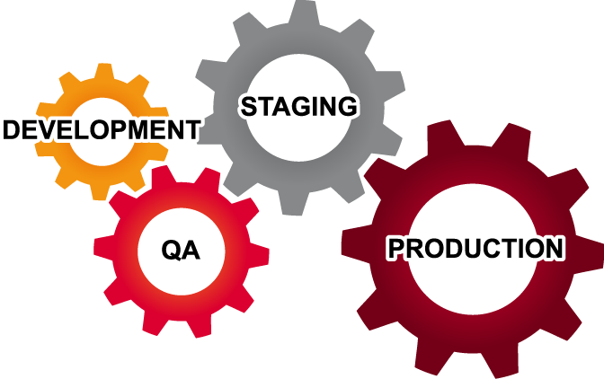
Where does testing happen?
Testing isn’t just done in QA
Be aware of the cost of fixing a bug
Notes:
There are pre-dev phases where testing could also happen –requirements analysis, architecture, functional specification.

Slide 27
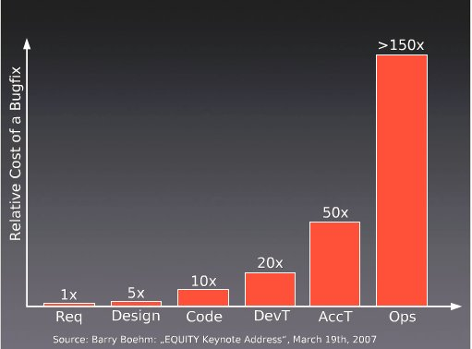
Cost of Bugs

Slide 28
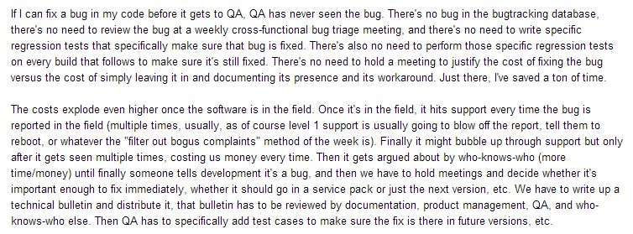
Does the cost of bugs rise?

Slide 29
Does the cost of bugs rise?

Slide 30
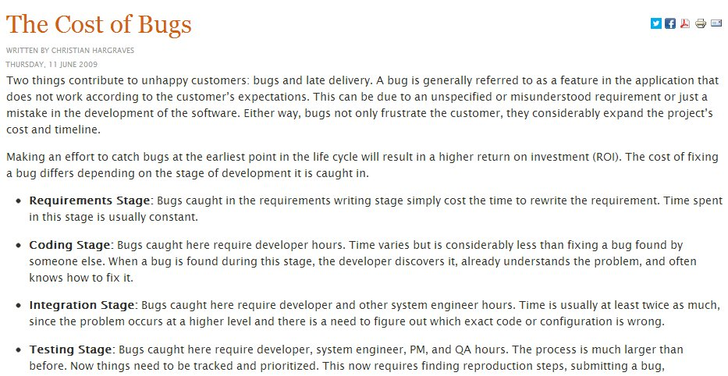

Slide 32
Testing in Development
Low(er) costs
No inter-team interactions
Changes are discrete
However
Increased frequency of changes (higher cost)
Notes:
Testing in development is preferred as the costs as low, or relatively low compared to finding bugs and issues later.
The lower costs come because testing is done in one team, or with one person. The changes are also discrete in that there aren’t a large bundle of changes being put together over time for deployment. Small bits of change are occurring.
However there are more changes, which means more costs to the tests and running a suite of tests.
The key here is automation.

Slide 33
What is test?
For .NET code, Nunit
Runs on a developer’s machine and build server
What about the database?
tSQLt is an open source framework for testing SQL Server databases
tSQLt.org
Support via GoogleGroups
SQL Test provides SSMS integration
Notes:
Although CI catches issues that arise when developers have failed run tests locally, also solving a different problem:
- Two incompatible changes committed by different developers
- “Works on my machine” in development.
Issues that only arise in more realistic integration environments.

Slide 34
Our story…
We want to set up a CI process for our database
Our database is in a VCS
We need to automatically build a new database on every check-in
Let’s add a unit test for our code to the CI process.
Notes:
Needs a new name, but this is where we talk about our demo app slightly (or code). Give a first requirement we need to do.

Slide 35
Demo
Testing the Build

Slide 36
Why generate test data?
Dev environments are often not realistic
Getting production data not always possible
Random data can result in surprises
Volume testing can find performance issues

Slide 37
Our story…
We want to set up a CI process for our database
Our database is in a VCS
We need to automatically build a new database on every check-in
Let’s add a unit test for our code to the CI process.
Let’s generate test data to use in our CI process
Notes:
Needs a new name, but this is where we talk about our demo app slightly (or code). Give a first requirement we need to do.

Slide 38
Demo
Testing with larger data sizes

Slide 39
Two bugs found by Test Data
NULL Dates
App code assumed [Date] wouldn’t be NULL
Test data didn’t
Fix was to change [Date] to be NOT NULL
Performance of v_Articles
Test passed on dev box
Failed in more “realistic” CI environment

Slide 40
Deployments Scripts
Creation scripts
For new installations
Upgrade Scripts
For existing installations
Developed by comparing our up-to-date database to production/test
Notes:
Creates database packages, used for reliable and repeatable deployments

Slide 41
Continuous delivery
1
2
START
3
4
DELIVER

Slide 42
The End
Questions?
More information: www.red-gate.com/CI
Please fill out your feedback forms
www.voiceofthedba.com/talks

Slide 43
References
http://assets.red-gate.com/products/sql-development/assets/continuous-integration-using-red-gate-tools.pdf
http://www.jetbrains.com/teamcity/
http://developers.slashdot.org/story/03/10/21/0141215/software-defects---do-late-bugs-really-cost-more
http://tech.lds.org/index.php?option=com_content&view=article&id=238:the-cost-of-bugs&catid=1:miscellanous
http://www.manageware.co.il/solution/portfolio/auto-deploy/

